Slide 1


AGILE SOFTWARE DEVELOPMENT & SCRUM

Slide 2

INTRODUCTION TO AGILE
Agile is an iterative and flexible approach to software development.
Focuses on continuous delivery, collaboration, and customer feedback.
4 Core Values of Agile Software Development :
Individuals & interactions over processes & tools.
Working software over comprehensive documentation.
Customer collaboration over contract negotiation.
Responding to change over following a plan.

Slide 3

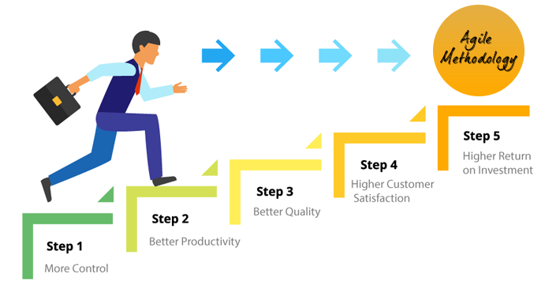
Why Agile?
Frequent Releases: Delivers working software in short time frames (1-4 weeks).
Customer-Centric Approach: Allows continuous input and adaptation to customer needs.
Better Risk Management: Detects and fixes issues early, reducing project failure chances.
Faster Time-to-Market: Speeds up development and ensures a competitive advantage.
Improved Quality: Regular testing and feedback ensure a bug-free and user-friendly product.

Slide 4
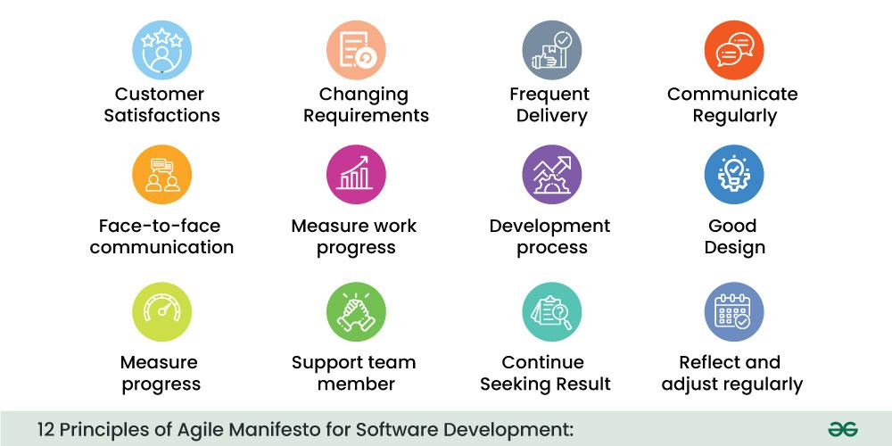
12 Principles of Agile Software Development

Slide 5
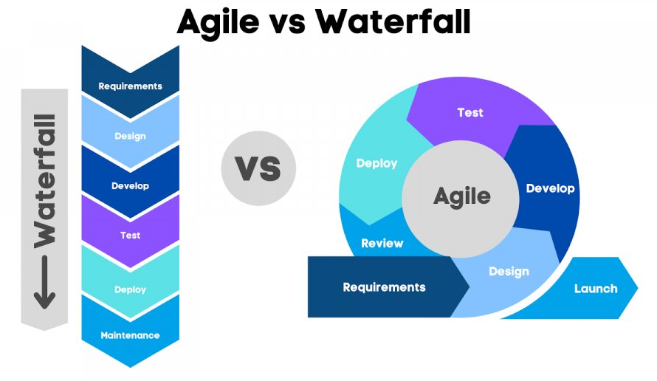
Feature | Agile | Waterfall
Flexibility | High | Low
Customer Involvement | Continuous | Limited
Risk Handling | Adaptive | Fixed Plan
Documentation | Minimal | Extensive
Delivery Time | Frequent Releases | End of Project

Slide 6
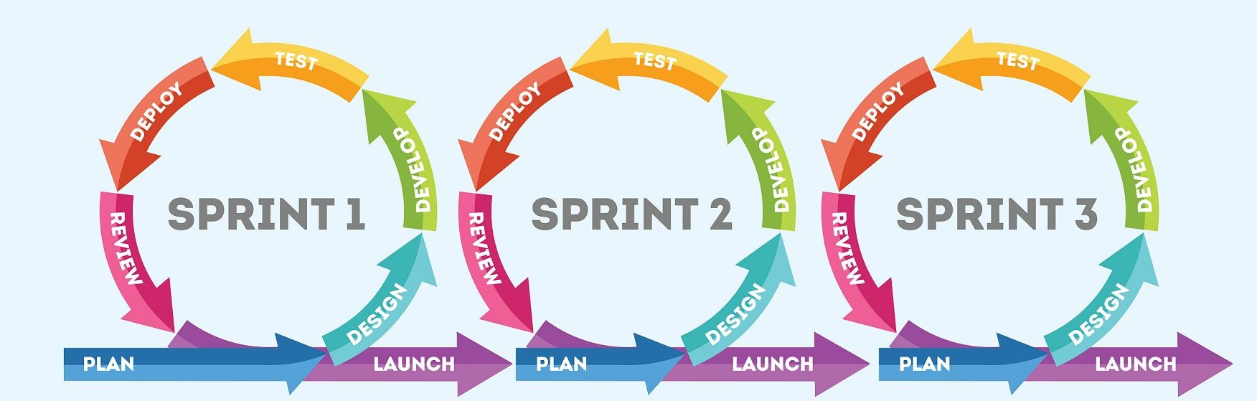
Example of Agile in Real Life
Spotify uses Agile to continuously improve its app and deliver a better user experience.
How Agile Helps:
Spotify breaks its teams into "Squads" (small Agile teams) that focus on different features like recommendations, playlists, and user interface.
Features are developed in short iterations (Sprints), tested, and released quickly.
User feedback is gathered continuously to improve features.
Teams follow Scrum and Kanban methodologies to manage workflows.

Slide 7
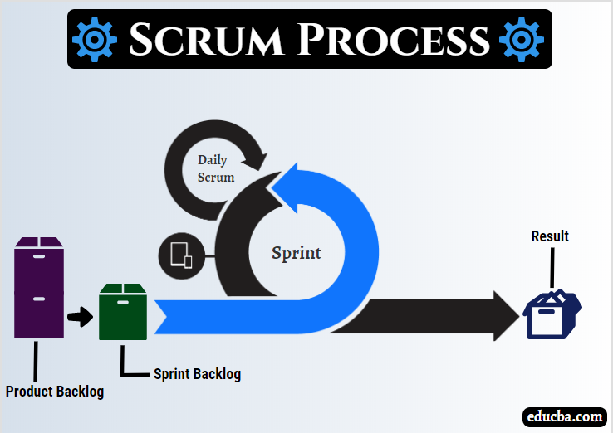
SCRUM
Scrum is an Agile framework used for software development.
It is based on iterative and incremental development.
Small teams collaborate to deliver working software in short cycles called Sprints
Scrum Team Roles : 1️⃣ Product Owner – Defines project vision & backlog. 2️⃣ Scrum Master – Ensures smooth Scrum execution. 3️⃣ Development Team – Builds and delivers the product.

Slide 8
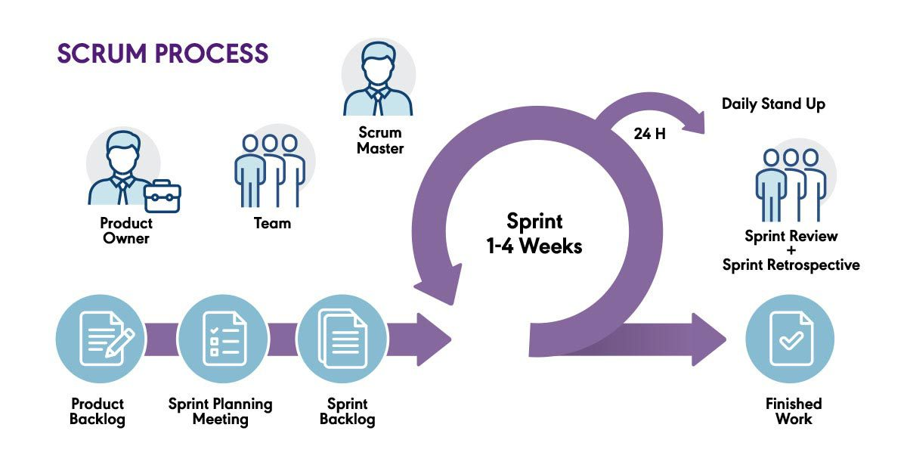
KEY COMPONENTS OF SCRUM
Product Backlog: A prioritized list of features & tasks.
Sprint Planning: Team selects tasks for the next Sprint.
Sprint (1-4 weeks): Development & testing cycle.
Daily Scrum Meeting: 15-minute standup for updates.
Sprint Review: Demonstrate completed work.
Sprint Retrospective: Identify improvements for the next Sprint.

Slide 9
THANK YOU

